Slide 1
Conclusion of Day 1

Slide 2
Day 1

Slide 3
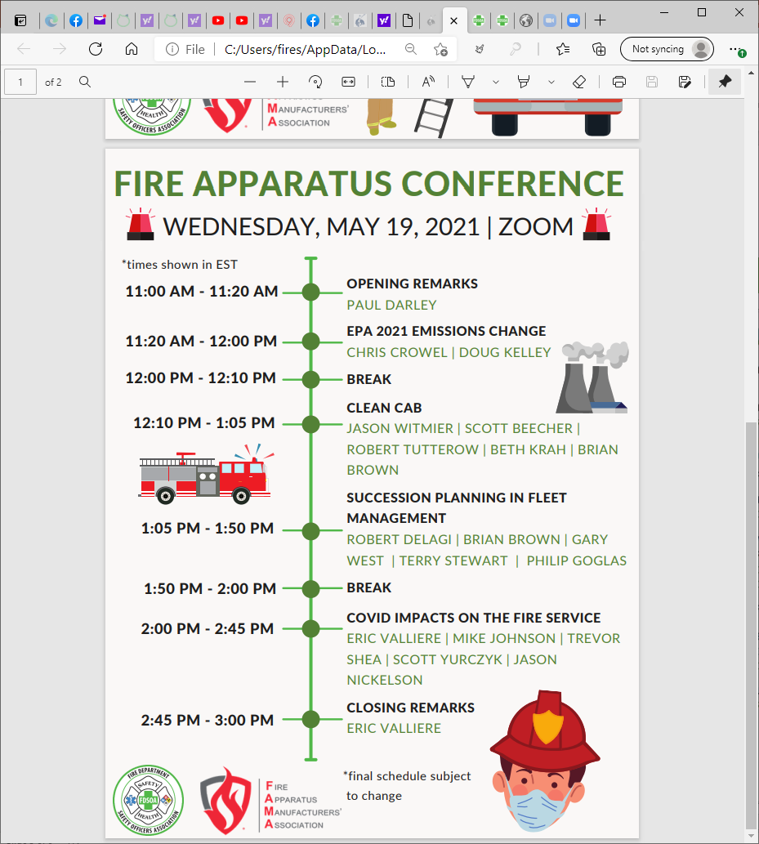
Day 2 Program

Slide 4
Thank you for attending!
Feedback is appreciated!
What did you like?
What would you like more of?
How could we improve?
Network
Connect with others (Attendees, FDSOA,FAMA)
Connect with Sponsors

